Slide 1

EXCEL MODULE 1 – SHORTCUTS​
Enhancing Your Data Analysis Skills Pathway
2023

Slide 2
Agenda
Selecting rows
Selecting columns
Selecting and navigating a range of cells
Other navigation short cuts
Exercise

Slide 3
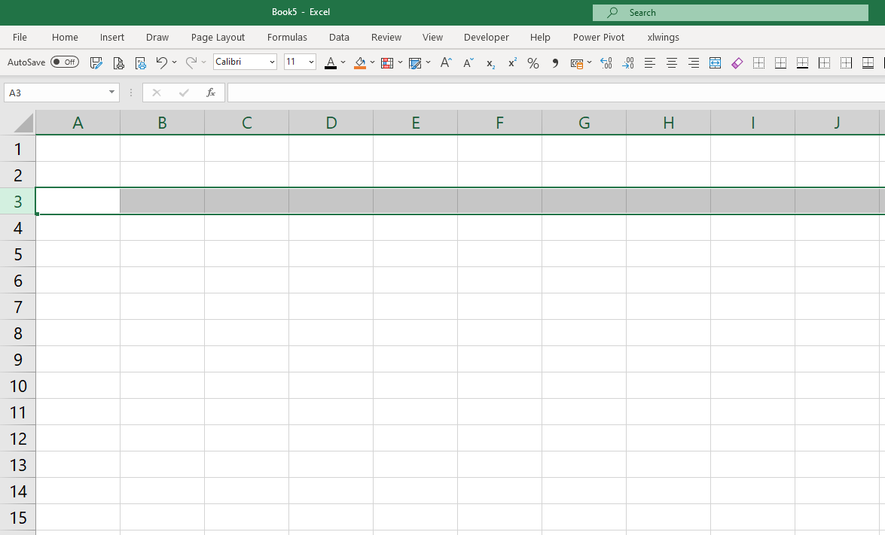
Selecting rows
Hold SHIFT + ⬆ or ⬇ arrow keys to select multiple rows
Use CTRL + C or CTRL + X and CTRL + V
To copy / cut / paste a row
SHIFT + Spacebar
=
Select entire ROW
Use CTRL + ‘+’ to insert a row under the selected row
Use CTRL + ‘-’ to delete the selected row

Slide 4
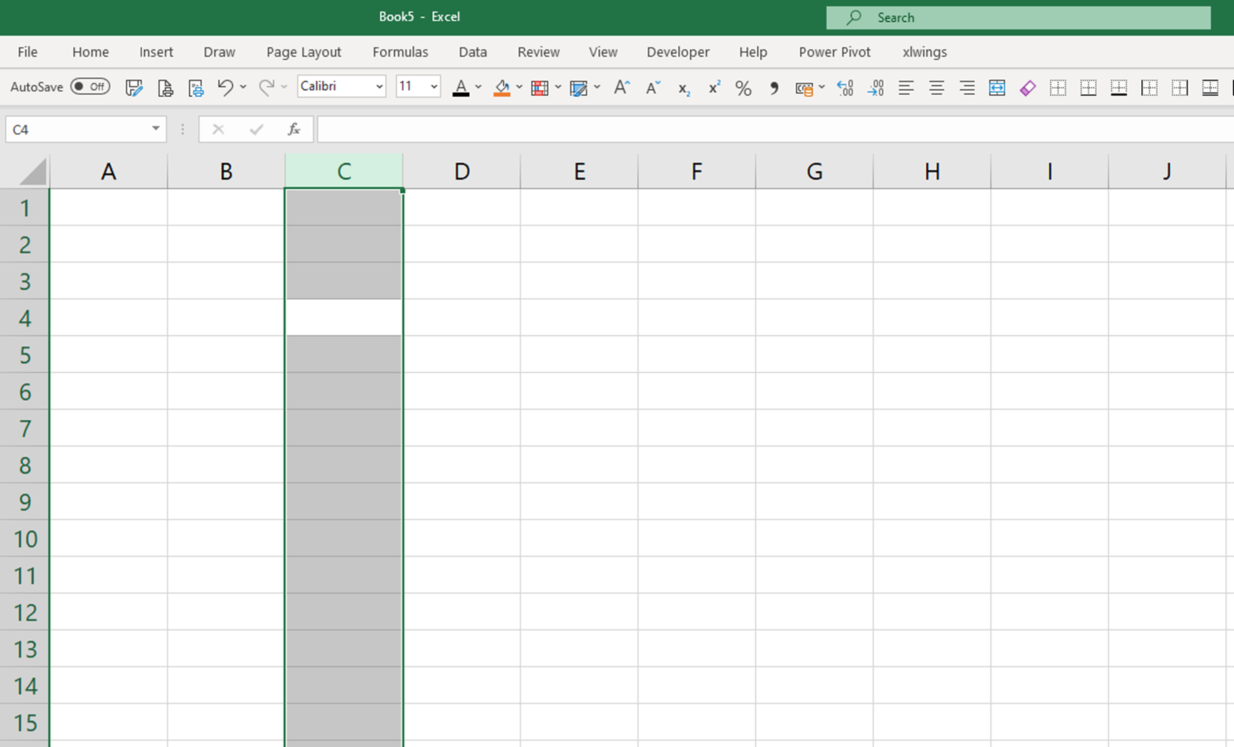
Selecting columns
Hold SHIFT + ➔ or ⬅ arrow keys to select multiple rows
CTRL + Spacebar
=
Select entire COLUMN
Use CTRL + ‘+’ to insert a column on the right of the selected column
Use CTRL + ‘-’ to delete the selected column
Use CTRL + C or CTRL + X and CTRL + V
To copy / cut / paste a row

Slide 5
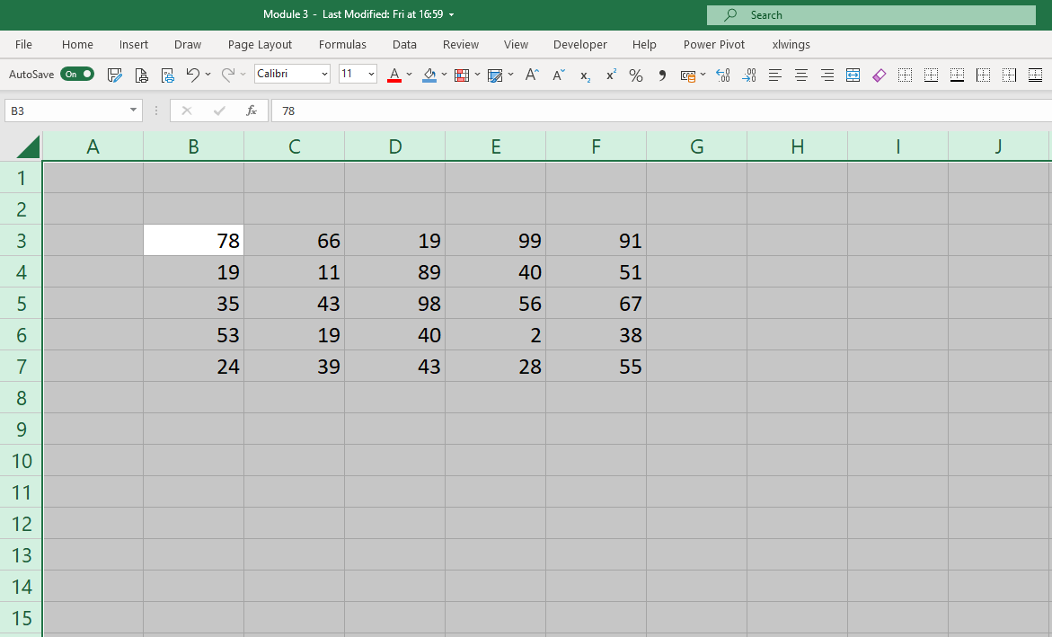
Selecting a range of cells
CTRL + A
=
Select entire range of adjacent CELLS
When pressing CTRL + A a second time, you select the entire worksheet
Notes:
Column: Vertical series of adjacent cells from top to bottom
Row: Horizontal series of cells from left to right
Cell: Intersection of a row and column
Active Cell: Cell that is currently selected
Cell range: Series or block of adjacent cells
This range here would be indicated as cell E5 to G7. So from the top left hand cell to the bottom righthand cell.

Slide 6
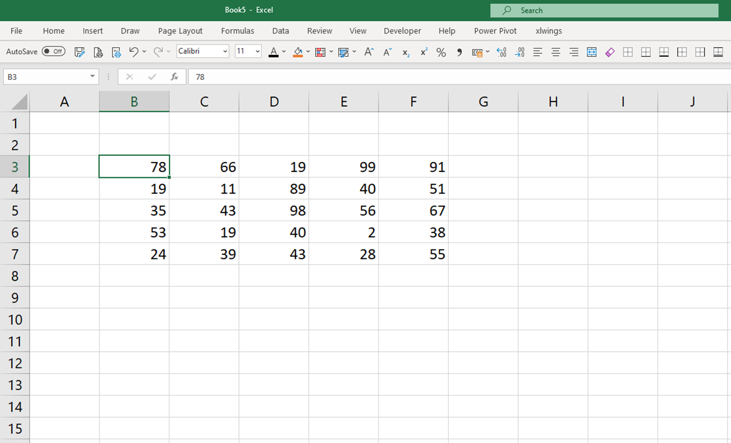
navigating a range of cells
CTRL + arrow keys
=
Jump to ends of a range of cells
Notes:
Column: Vertical series of adjacent cells from top to bottom
Row: Horizontal series of cells from left to right
Cell: Intersection of a row and column
Active Cell: Cell that is currently selected
Cell range: Series or block of adjacent cells
This range here would be indicated as cell E5 to G7. So from the top left hand cell to the bottom righthand cell.

Slide 7
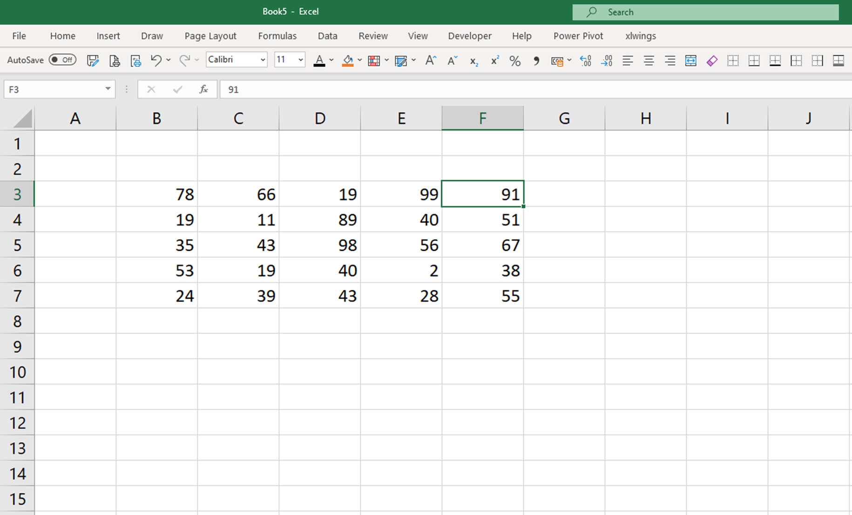
navigating a range of cells
CTRL + ➔
=
Jump to the right of the range
CTRL + arrow keys
=
Jump to ends of a range of cells

Slide 8
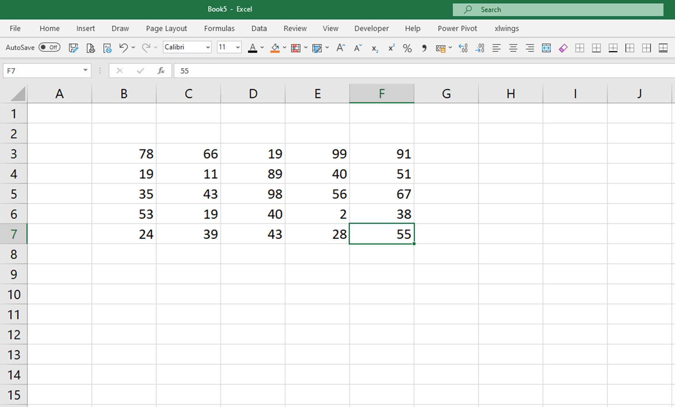
navigating a range of cells
CTRL + arrow keys
=
Jump to ends of a range of cells
CTRL + ⬇
=
Jump to the bottom of the range

Slide 9
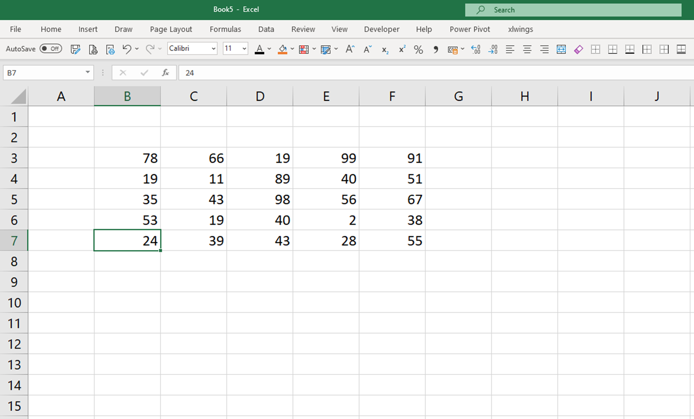
navigating a range of cells
CTRL + ⬅
=
Jump to the left of a range
CTRL + arrow keys
=
Jump to ends of a range of cells

Slide 10
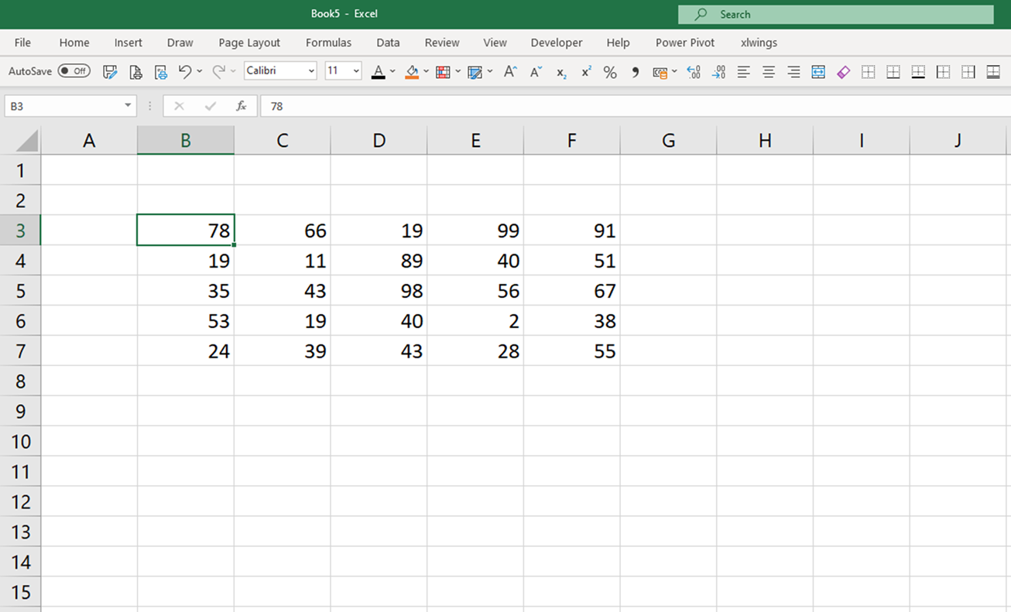
navigating a range of cells
CTRL + ⬆
=
Jump to the top of a range
CTRL + arrow keys
=
Jump to ends of a range of cells

Slide 11
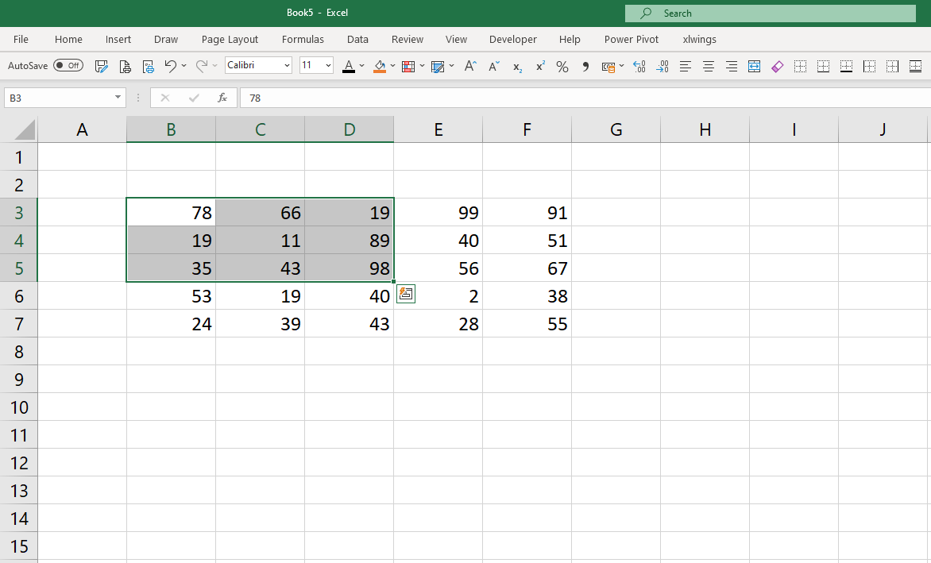
navigating a range of cells
SHIFT + arrow keys
=
Select a range of cells one row or column at a time

Slide 12
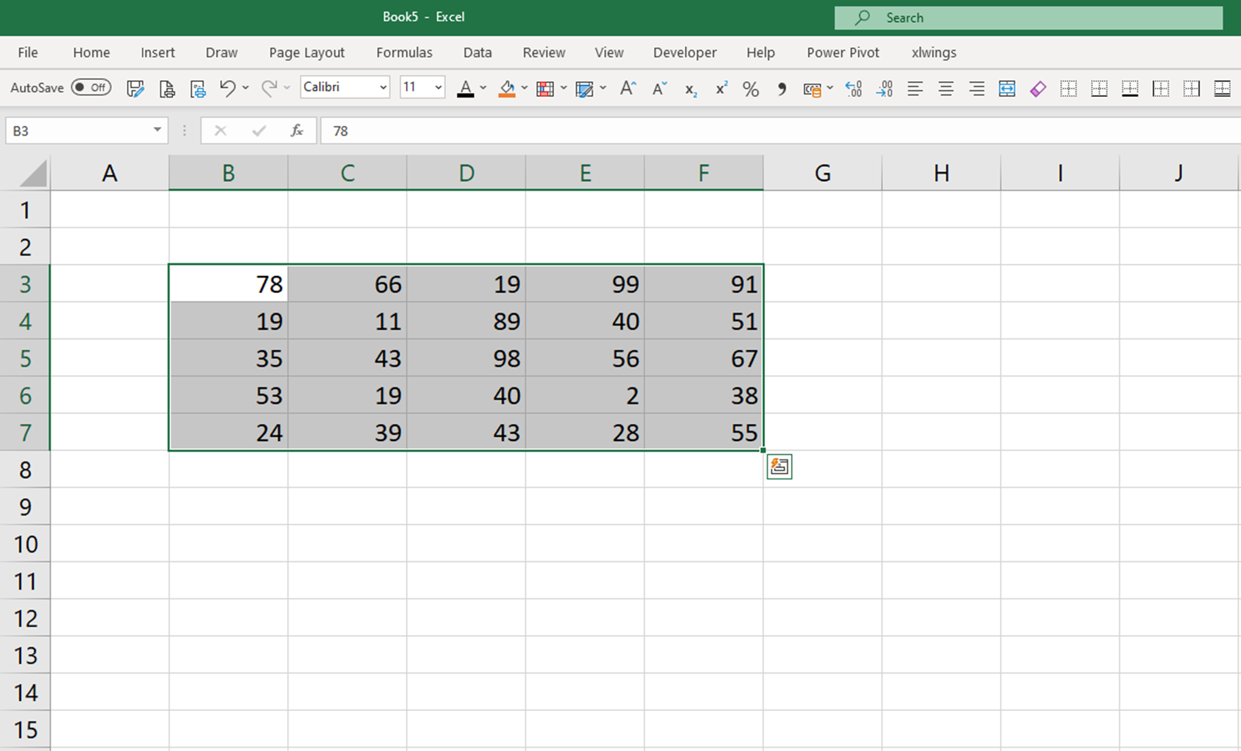
navigating a range of cells
CTRL + SHIFT + ➔
=
Select and jump to the right of the range
CTRL + SHIFT + arrow keys
=
Select a range of cells while jumping to the end of a range
CTRL + SHIFT + ⬇
=
Select and jump to the bottom of the range

Slide 13
Other navigation short cuts
CTRL + HOME
Jump to cell A1
CTRL + END
Jump to bottom right hand corner of your worksheet
CTRL + PAGE UP
Move to the worksheet right of the current worksheet
CTRL + PAGE DOWN
Move to the worksheet left of the current worksheet

